Slide 1
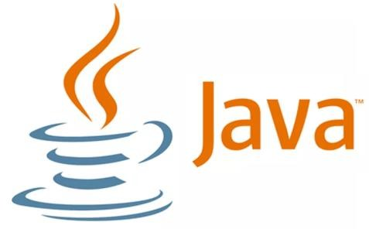
JAVA PROGRAMMING
UNIT - I
1

Slide 2
Syllabus
2
An Overview of Java:
Introduction to Object-
Oriented Programming, identifiers, literals, Data
Simple Java
Programs,
Types, Variables, and
Arrays: Java Is a Strongly Typed Language, The Primitive Types, Integers, Floating-Point Types, Characters, Booleans, Variables, Arrays, and Strings.

Slide 3
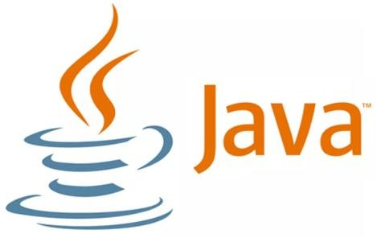

Introduction to Java
3
Java is an object-oriented programming language developed by Sun Microsystems, initiated by James Gosling
This language was initially called “Oak,” but was renamed “Java” in 1995

Slide 4
Object Oriented Programming
4
Object means a real world entity such as pen, chair, table etc.
Object-Oriented Programming
is a methodology or paradigm to design a program using classes and objects.

Slide 5
The Java Buzzwords
4
The Java programming language can be characterized by the following buzzwords:
Simple
Object-Oriented
Distributed
Compiled and Interpreted
Robust
Secure
Architecture-Neutral
Portable
High Performance
Multithreaded
Dynamic
A buzzword is a word or phrase, new or already existing, that becomes popular for a period of time

Slide 6
The Java Buzzwords
4
Simple
Java is designed to be easy for beginners and professional programmers to learn and use effectively.
It’s simple and easy to learn if you already know the basic concepts of Object-Oriented Programming.
Java has removed many complicated and rarely-used features, such as explicit pointers and operator overloading.

Slide 7
The Java Buzzwords
4
Distributed:
Java is designed to create distributed applications on networks.
Java applications can access remote objects on the Internet as easily as they can do in the local system.
Java enables multiple programmers at multiple remote locations to collaborate and work together on a single project.

Slide 8
The Java Buzzwords
4
Compiled and Interpreted:
Java combines both compiled and interpreted approaches, making it a two-stage system.
Compiled: Java compiles programs into an intermediate representation called Java Bytecode.
Interpreted: Bytecode is then interpreted, generating machine code that can be directly executed by the machine that provides a JVM.

Slide 9
The Java Buzzwords
4
Robust
Java provides many features that make programs execute reliably in a variety of environments.
Java is a strictly typed language that checks code at compile time and runtime.
Java handles memory management with garbage collection and captures serious errors through exception handling

Slide 10
The Java Buzzwords
4
Secure
Java does not use pointers, which helps prevent unauthorized memory access.
The JVM verifies Java bytecode before execution, ensuring that it adheres to Java’s security constraints.
Java applications run in a restricted environment (sandbox) that limits their access to system resources and user data, enhancing security.

Slide 11
The Java Buzzwords
4
Architecture-Neutral
Java language and JVM help achieve the goal of “write once; run anywhere, any time, forever.”
Changes and upgrades in operating systems, processors, and system resources do not force any changes in Java programs.

Slide 12
The Java Buzzwords
4
Portable:
Java provides a way to download programs dynamically to various types of platforms connected to the Internet.
Java is portable because of the JVM, which provides a consistent runtime environment across different platforms.
High Performance:
Java performance is high because of the use of bytecode.
The bytecode can be easily translated into native machine code.

Slide 13
Multithreaded:
Multithreaded programs handle multiple tasks simultaneously, which is helpful in creating interactive, networked programs.
Java run-time system supports multiprocess synchronization for constructing interactive systems.
Dynamic:
Java can link in new class libraries, methods, and objects dynamically.
Java programs carry substantial amounts of run-time type information, enabling dynamic linking in a safe and expedient manner.
4

Slide 14
The Java Buzzwords
5
Object-Oriented
It simplifies the
software development and
maintenance by providing some concepts:
Object
Class
Inheritance
Polymorphism
Abstraction
Encapsulation

Slide 15
Object..
6
In simple words, object is a real word entity.
For example, dog, car, pen, desk, etc. Each object shares the following two characteristics:
State: The state of an object stored in variables
(fields).
Behavior: The methods shows the behavior of an object.
Example of an Object – Student
🞑 The state of student includes, name,marks,subjects.
🞑 The behavior includes accept(),display() etc.

Slide 16
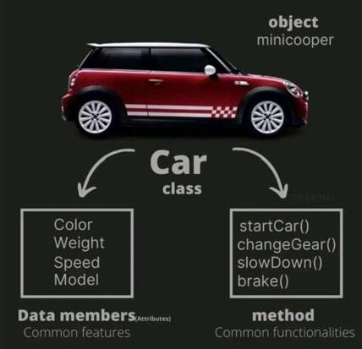
Class
7
Collection of objects is called class.
Class is not a real world entity. It is just a template or blueprint or prototype from which objects are created.
Class does not occupy memory.
Class is a group of variables of different data types and group of methods.
A class in java can contain:
data /Variables
methods
constructors
nested class and
interfaces

Slide 17
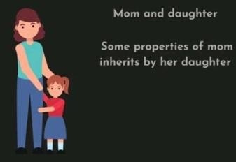
Inheritance
8
Inheritance is the process by which one object acquires the properties of another object.(Variables and methods).
In Java, inheritance means creating new classes based on existing ones.
A class that inherits from another class can reuse the methods and variables of that class.
In addition, you can add new variables and methods to your current class as well. It provides code reusability.

Slide 18

Polymorphism
9
Polymorphism means "many forms“
A person at the same time can have different characteristics. Like a man at the same time is a father, a husband, an employee. So the same person possesses different behavior in different situations. This is called polymorphism.
Two types of polymorphism in Java: compile-time polymorphism and runtime polymorphism.
Example : method overloading and method overriding.

Slide 19
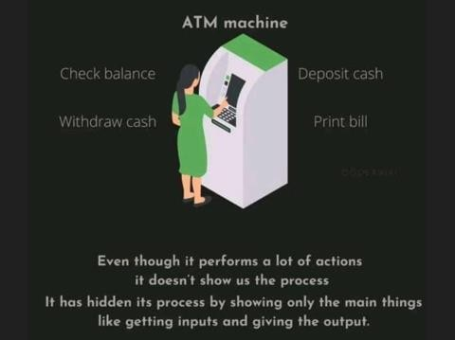
Abstraction
10
Hiding internal details and showing functionality is known as abstraction.
For example: ATM machine, we don't know the internal processing.
In java, we use abstract class and interface to achieve abstraction.

Slide 20

Encapsulation
11
Binding (or wrapping) code and data together into a single unit is known as encapsulation.
🞑 For example: capsule, it is wrapped with medicines.
A java class is the example of encapsulation.
different

Slide 21
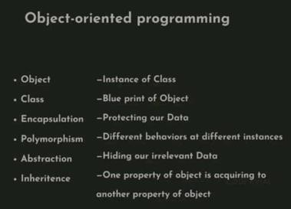
OOP Concepts …Finally
12

Slide 22
Types of Java Applications
21
Standalone Application
🞑 It is also known as desktop application or window- based application.
🞑 An application that we need to install on every machine such as media player, antivirus etc.
🞑 AWT and Swing are used in java for creating standalone applications.

Slide 23
Types of Java Applications
22
Web Application
🞑 An application that runs on the server side and creates dynamic page, is called web application.
🞑 Currently, servlet, jsp, struts, jsf etc. technologies are used for creating web applications in java.

Slide 24
Types of Java Applications
23
Enterprise Application
An application that is distributed in nature, such as banking applications etc.
It has the advantage of high level security, load balancing and clustering.
In java,Enterprise Java Beans(EJB) is used for creating enterprise applications.
Mobile Application
An application that is created for mobile devices.
Currently Android and Java Micro Edition(ME) are used for creating mobile applications.

Slide 25
First Java Program
24
class HelloWorld
{
public static void main (String args[])
{
System.out.println ("Hello World");
}
}

Slide 26
First Java Program ….
25
In Java, all code must reside inside a class and the name of that class should match the name of the file that holds the program.
For this example, the name of the source file should be HelloWorld.java
The Java compiler requires that a source file use the .java filename extension.

Slide 27
First Java Program …
26
The keyword 'public' says that, It is used to specify that the function has no restriction on being used anywhere throughout system.
The main( ) can be accessed outside the defining class.
The keyword 'static' indicates that a function can be accessed without an object. just using the class name. JVM call main using the ClassName.methodName(Helloworld.main) notation

Slide 28
The keyword 'void' indicates that a function does not return any value.
The 'main' is the name of the function and entry point for a Java application.
String args [ ] declares a parameter named args, which is an array of the class String. Objects of type String store character strings. args receives any command-line arguments present when the program is executed.

Slide 29
System.out.println()
Used to print a line of text followed by a new line.
System – is a final class in java.lang package.
out – is a static member field of System class and is of type PrintStream.
out is a public static member of class System.
out represents the standard output (similar to stdout or cout)
println is a public method of the class of which out is an object.

Slide 30
System.out.print() is similar to System.out.println(), but does not print a new line automatically.
System.out.printf() is used to print formatted output like printf() in C
In Java, characters enclosed by double quotes ("") represents a String object, where String is a class of the Java API.
We can use the plus operator (+) to concatenate multiple String objects and create a new String object

Slide 31
Variants of main() in Java
27
Default:
🞑public static void main(String args[])
Variants:
🞑 static public void main(String args[])
🞑 public static void main(String[] args)
🞑 public final static void main(String[] args)
🞑 public synchronized static void main(String[] args)

Slide 32
Example2
30
This is a simple Java program.
class Example2 {
public static void main(String args[])
{
System.out.println(“Good Morning");
}
}

Slide 33
Static methods can be called directly using method name.
public class Main
{
static void myMethod()
{
System.out.println("I just got executed!");
}
public static void main(String[] args)
{
myMethod();
}
}

Slide 34
Non-Static methods can be called by creating an object
public class Main
{
void myMethod()
{
System.out.println("I just got executed!");
}
public static void main(String[] args)
{
Main obj=new Main();
Obj.myMethod();
}
}
34

Slide 35
//Program to find sum of two numbers
class Addition
{
//Declaring instance variable
int a=20;
int b=30;
System.out.println(a+b); //Invalid Syntax
void add()
{
System.out.println(a+b);
}
public static void main(String[] args)
{
Addition obj=new Addition();
Obj.add();
}
}
35

Slide 36
Write a Program to print the area of triangle
class Area {
public static void main(String args[])
{
int height =10,base=6;
float area=0.5F*base* height;
System.out.println(“area of triangle = ”+area);
}
}
36

Slide 37
Identifiers
33
Identifiers are used for class names, method names, and variable names.
An identifier may be any descriptive sequence of Alphabets[a- z A-Z],Digits[0-9], the underscore(_) and dollar-sign($) characters.
They must not begin with a Digits.
Some examples of valid identifiers are:
🞑 AvgTemp, count, A4, $count, Sum_of_digits
Invalid Identifiers:
🞑 4sum, sum-avg, yes/no

Slide 38
Literals
34
A constant value in Java is created by using a
literals.
For example, here are some literals:
100 , 120.5f , ‘x’ , “Good Morning”
The first literal specifies an integer, the next is a floating-point value, the third is a character constant, and the last is a string.

Slide 39
Example3
35
class Example3 {
public static void main(String args[]) {
int num;
num = 100;
// this declares a variable called num
// this assigns num the value 100
System.out.println("This is num: " + num); num = num * 2;
System.out.print("The value of num * 2 is "); System.out.println(num);
}
}

Slide 40
Java is a strongly Typed Language
Every variable has a type, every expression has a type and every type is strictly defined.
There are no automatic conversions of conflicting types as in other languages.
The java compiler checks all expressions and parameters to ensure that the types are compatible.
Any type mismatches are errors that must be corrected before the compiler will finish compiling the class.

Slide 41
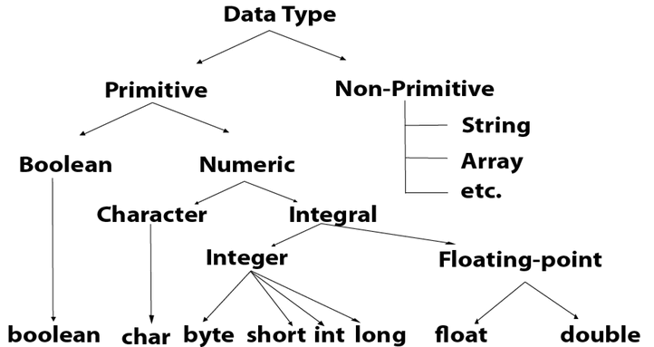
Java Data Types

Slide 42
Java Data Types
36
Primitive data types or simple or Basic data types:
- byte, short, int, long, float, double, boolean and char.
These can be put in four groups:
i) Integers - This group includes byte, short, int, and long, which are for whole-valued signed ,positive and negative numbers.
Integers does not support unsigned.

Slide 43
Primitive data types
ii) Floating-point numbers - This group includes float and double, which represent numbers with fractional precision.
iii)Characters - This group includes char, which represents symbols in a character set, like letters and numbers.
iv)Boolean - This group includes Boolean, which is a special.
Declarations look like C, for example,
double x, y;
int count = 0;
2. Non-primitive data types – Arrays, Strings and Classes.

Slide 44
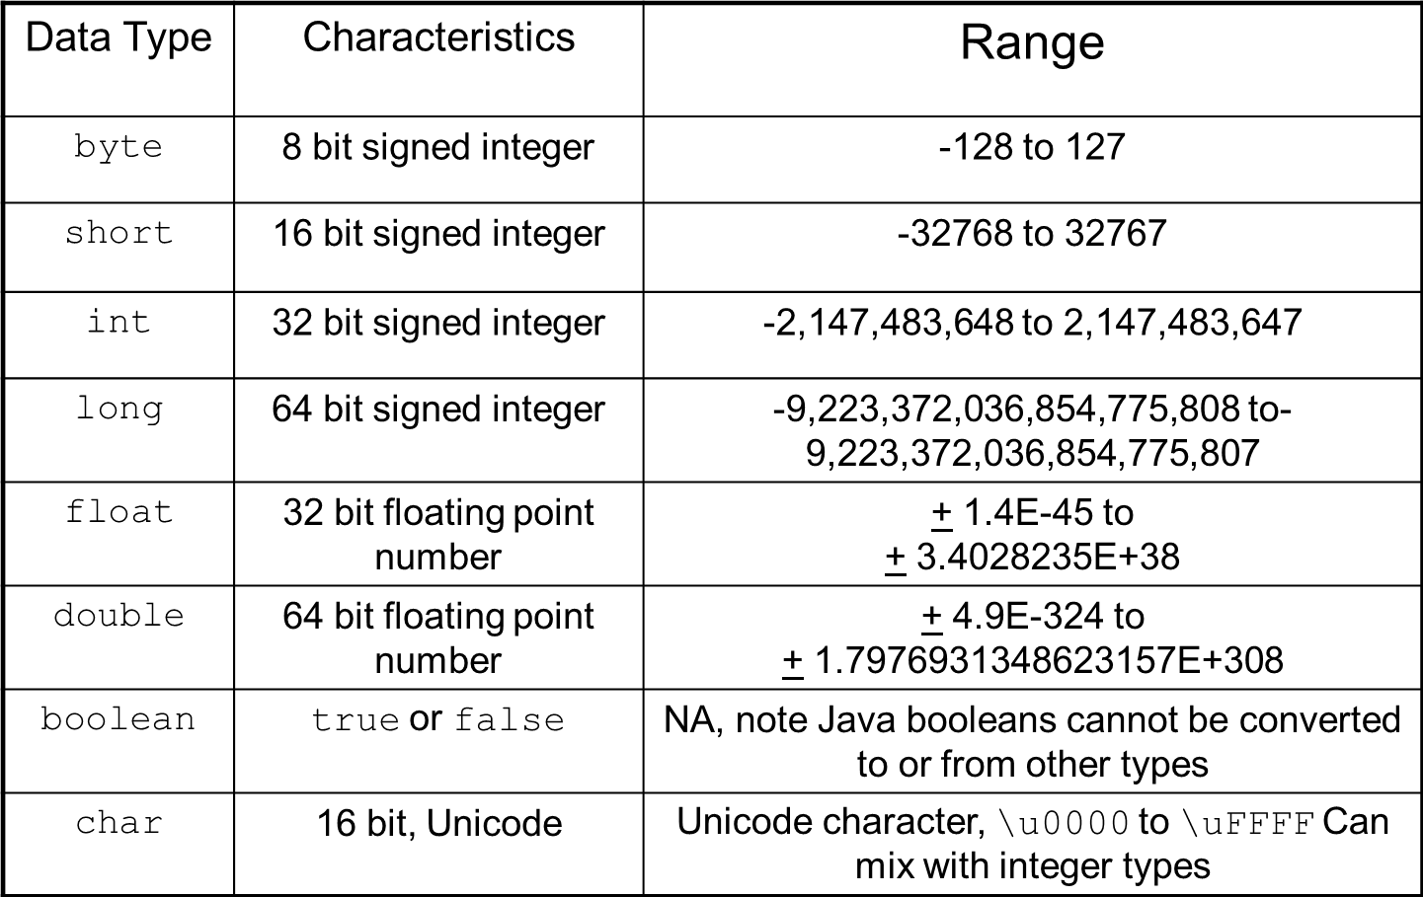
Java Primitive Data Types
38

Slide 45
Variables
39
The variable is the basic unit of storage in a Java program.
A variable may contain alphabets, digits, underscore and dollar sign.
In addition, all variables have a scope, which defines their visibility, and a lifetime.
Its value is changing during program execution.

Slide 46
Variables
39
Declaring a Variable In Java,
type identifier<space> Variable names separated by comma ;
Examples:
int a, b, c; // declares three integers a, b, and c.
int d = 3, e, f = 5;
byte z = 22; // initializes z.
double pi = 3.14159; // declares an approximation of pi.
char x = 'x’; // the variable x has the value 'x'

Slide 47
Variables … Scope and Lifetime
44
class Scope {
// Demonstrate block scope.
public static void main(String args[])
{ int x; // known to all code within main x = 10;
if(x == 10)
{ // start new scope
int y = 20; // known only to this block
// x and y both known here.
System.out.println("x and y: " + x + " " + y);
x = y * 2;
}
// y = 100; // Error! y not known here
// x is still known here.
System.out.println("x is " + x);
}
}

Slide 48
Variables … Scope and Lifetime
45
Variables are created when their scope is entered, and destroyed when their scope is left.
A variable declared within a block will lose its value when the block is left. Thus, the lifetime of a variable is confined to its scope.

Slide 49
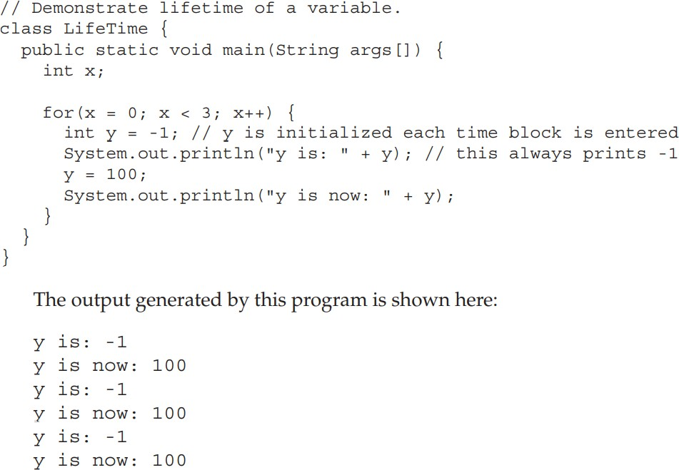
Variables … Scope and Lifetime
46

Slide 50
Program to compute area of Circle
47
class Area
{
public static void main(String args[])
{
double pi, r, area;
r = 10.8; // radius of circle
pi = 3.1416; // pi, approximately area = pi * r * r; // compute area
System.out.println("Area of circle is " + a);
}
}

Slide 51
Demonstrate char data type.
48
class CharDemo
{
public static void main(String args[])
{
char ch1, ch2;
ch1 = 88; // code for X ch2 = 'Y’;
System.out.print("ch1 and ch2: "); System.out.println(ch1 + " " + ch2);
}
}
output:
ch1 and ch2: X Y

Slide 52
char variables behave like integers.
49
class CharDemo2 {
public static void main(String args[]) { char ch1;
ch1 = 'X’;
System.out.println("ch1 contains " + ch1); ch1++; // increment ch1 System.out.println("ch1 is now " + ch1);
}
}
Output :
ch1 contains X
ch1 is now Y

Slide 53
Boolean
50
Java has a primitive type, called boolean, for logical values.
It can have only one of two possible values, true or false.
This is the type returned by all relational operators.
Variables are created using the keyword boolean.
boolean b; // b stores either true or false value we can assign the value for b;
b=false;

Slide 54
Demonstrate boolean values.
51
class BoolTest {
public static void main(String args[]) { boolean b;
b = false;
System.out.println("b is " + b); b = true;
System.out.println("b is " + b);
if(b)
// a boolean value can control the if statement System.out.println("This is executed.");
b = false;
if(b)
System.out.println("This is not executed.");
// outcome of a relational operator is a boolean value
System.out.println("10 > 9 is " + (10 > 9));
}
}

Slide 55
Type Conversion and Casting
Types of Type Casting:
There are two types of type casting:
Widening Type Casting
Narrowing Type Casting

Slide 56
Widening Type Casting
Converting a lower data type into a higher one is called widening type casting.
It is also known as implicit conversion or casting down.
It is done automatically.
It is safe because there is no chance to lose data.
It takes place when:
Both data types must be compatible with each other.
The target type must be larger than the source type.
byte -> short -> char -> int -> long -> float -> double

Slide 57
public class WideningTypeCastingExample
{
public static void main(String[] args)
{
int x = 7;
//automatically converts the integer type into long type
long y = x;
//automatically converts the long type into float type
float z = y;
System.out.println("Before conversion, int value "+x);
System.out.println("After conversion, long value "+y);
System.out.println("After conversion, float value "+z);
}
}

Slide 58
Narrowing Type Casting
Converting a higher data type into a lower one is called narrowing type casting.
It is also known as explicit conversion or casting up.
It is done manually by the programmer.
If we do not perform casting, then the compiler reports a compile-time error.
double -> float -> long -> int -> char -> short -> byte
Data loss in narrowing conversions.

Slide 59
Narrowing Type Casting
public class NarrowingTCExample
{
public static void main(String args[])
{
double d = 166.66;
//converting double data type into long data type
long l = (long)d;
//converting long data type into int data type
int i = (int)l;
System.out.println("Before conversion: "+d);
//fractional part lost
System.out.println("After conversion into long type: "+l);
//fractional part lost
System.out.println("After conversion into int type: "+i);
}
}

Slide 60
NOTE:
There are no automatic conversions from the numeric types to char or boolean.
Also, char and boolean are not compatible with each other.
Example1: byte b = 50;
b = b * 2; // Error! Cannot assign an int to a byte!
The code is attempting to store 50 * 2, a perfectly valid byte value, back into a byte variable. However, because the operands were automatically promoted to int when the expression was evaluated, the result has also been promoted to int.
which cannot be assigned to a byte without the use of a cast.
byte b = 50;
b = (byte)(b * 2); //correct

Slide 61
Arrays
52
An array is a collection of similar data items that are referred by common name and stored in continuous memory location.
A specific element in an array is accessed by its index.
NOTE If you are familiar with C/C++, be careful. Arrays in Java work differently than they do in those languages.

Slide 62
One-Dimensional Arrays
53
The general form of a one-dimensional array declaration is:
datatype var-name[ ];
or
datatype [] var-name;
Ex: int [] arr; //When array is declared only a reference of an array is created.
To create or give memory to the array.

Slide 63
Arrays …
54
The general form of one-dimensional array initialization is:
🞑 var-name = new datatype[size];
new is a special operator that allocates memory.
The elements in the array allocated by new will automatically be initialized to zero.
It is possible to combine the declaration of the array variable with the allocation of the array itself, as shown here:
🞑 int month_days[] = new int[12];

Slide 64
Arrays …
55
Obtaining an array is a two-step process:
🞑 Declare a variable of the desired array type.
🞑 Allocate the memory that will hold an array using new, and assign it to the array variable.
int arr[];
arr=new int[20]; OR
Thus, in Java all arrays are dynamically allocated.
All array indexes start at zero.
int arr[]=new int[2];

Slide 65
Demonstrate a one-dimensional array.
A program that creates an array of the number of days in each month.
56
class Array {
public static void main(String args [ ]){
int month_days[ ];
month_days = new nt[12];
month_days[0] = 31;
month_days[1] = 28;
month_days[2] = 31;
month_days[3] = 30;
month_days[4] = 31;
month_days[5] = 30;
month_days[6] = 31;
month_days[7] = 31;
month_days[8] = 30;
month_days[9] = 31;
month_days[10] = 30;
month_days[11] = 31;
System.out.println("April has " + month_days[3] + " days.");
}
}

Slide 66
Array initialization
58
For example, to store the number of days in each month, the following code creates an initialized array of integers: An improved version of the previous program.
class AutoArray {
public static void main(String args[]) {
int month_days[] = { 31, 28, 31, 30, 31, 30, 31, 31, 30, 31,30, 31 };
System.out.println("April has " + month_days[3] + " days.");
}
}

Slide 67
Program to find average of set of numbers
59
// Average an array of values. class Average {
public static void main(String args[]) {
double nums[] = {10.1, 11.2, 12.3, 13.4, 14.5};
double result = 0;
int i;
for(i=0; i<5; i++) or for(i=0; i<nums.length; i++)
result = result + nums[i]; System.out.println("Average is " + result / 5);
}
}

Slide 68
Multidimensional Arrays
60
In Java, multidimensional arrays are actually arrays of arrays. ie. More than one dimension.
For example, the following declares a two dimensional array variable called twoD.
int twoD[ ][ ] = new int[4][5];
int [][] twoD=new int[4][5];
This allocates a 4 by 5 array and assigns it to twoD.
Internally this matrix is implemented as an array of arrays of int.

Slide 69
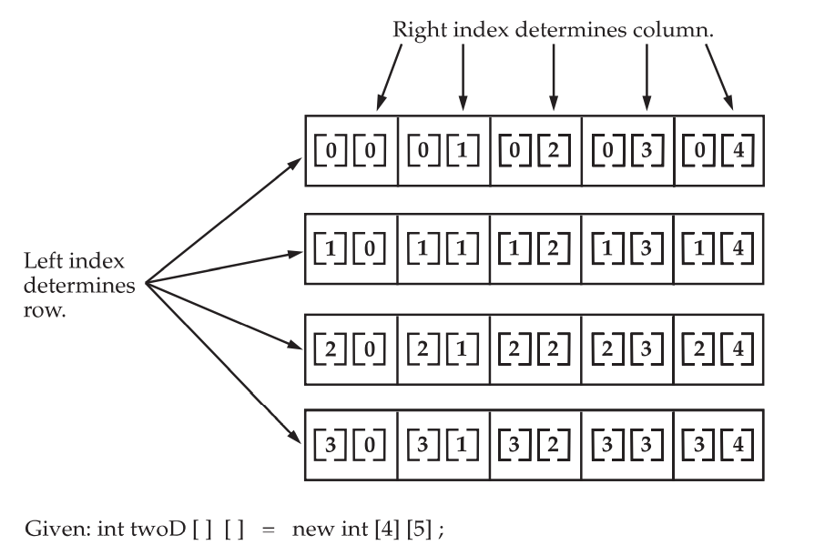
Multidimensional Arrays
61
Conceptually, this array will look like the one shown in Figure.

Slide 70
Demonstrate a two-dimensional array.
62
class TwoDArray {
public static void main(String args[]) {
int twoD[][]= new int[4][5]; int i, j, k = 0;
for(i=0; i<4; i++)
for(j=0; j<5; j++) {
twoD[i][j] = k; k++;
}
for(i=0; i<4; i++) {
for(j=0; j<5; j++)
System.out.print(twoD[i][j] + " "); System.out.println();
}
}
}

Slide 71
Program creates a matrix where each element contains the product of the row and column indexes.
65
class Matrix {
public static void main(String args[]) { int m[ ][ ] = {
{ 0*0, 1*0, 2*0, 3*0 },
{ 0*1, 1*1, 2*1, 3*1 },
{ 0*2, 1*2, 2*2, 3*2 },
{ 0*3, 1*3, 2*3, 3*3 }
};
int i, j;
for(i=0; i<4; i++) {
for(j=0; j<4; j++)
System.out.print(m[i][j] + " "); System.out.println();
}
}
}

Slide 72
Alternative Array Declaration Syntax
67
type[ ] var-name;
The following two declarations are equivalent:
🞑 int al[] = new int[3];
🞑 int []a2 = new int[3];
The following declarations are also equivalent:
🞑 char twod1[][] = new char[3][4];
🞑 char[][] twod2 = new char[3][4];
Declaring several arrays at the same time.
🞑 int [] nums, nums2, nums3; // create three arrays, creates
//three array variables of type int. It is the same as writing
🞑 int nums[], nums2[], nums3[]; // create three arrays

Slide 73
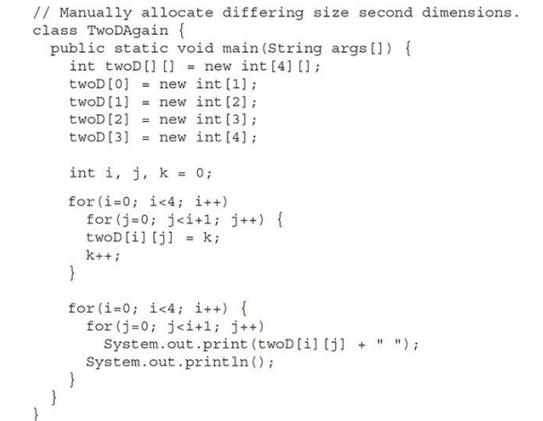
OUTPUT:
0
1 2
3 4 5
6 7 8 9

Slide 74
Following code allocates memory for the first dimension of twoD when it is declared. It allocates the second dimension separately.
int twoD[][] = new int[4][];
twoD[0] = new int[5];
twoD[1] = new int[5];
twoD[2] = new int[5];
twoD[3] = new int[5];
When you allocate dimensions individually, you do not need to allocate the same number of dimensions individually, you do not need to allocate the same number of elements for each dimension

Slide 75
Strings
68
String - array of characters, String defines an object.
String type is used to declare string variables,
🞑 String str;
A quoted string constant can be assigned to a String variable.
🞑 str = “Dept of ISE"; or String str = “Dept of ISE";
A variable of type String can be assigned to another variable of type String.
🞑 String s;
🞑 s=str;

Slide 76
Strings …
69
Declares arrays of strings.
String[] strar1; //Declaration of String Array without size String[] strar2 = new String[2]; //Declaration with size
String array Initialization:
String[] str1 = {"mon", "tue", " wed"};
String[] str2=new String[] {"mon", “tue", " wed"};
String[] str3= new String[3]; str3[0]=“mon”;
str3[1]=“tue”;
str3[2]=“wed”;

Slide 77
Strings…
70
You can use an object of type String as an argument to println( ).
For example,
🞑 String str = "Dept of ISE";
🞑 System.out.println(str);
Here, str is an object of type String. It is assigned the string “Dept of ISE”. This string is displayed by the println( ) statement.

Slide 78
Strings …
71
class mystr {
public static void main(String[] args) {
String []months= {"Jan", "Feb", "Mar", "April"}; for (String i : months) {
System.out.println(i);
}
}
}

Slide 79
Strings …
71
Java strings is that they must begin and end on the same line.
There is no line-continuation escape sequence as there is in some other languages.
strings are implemented as arrays of characters. However, this is not the case in Java.
Strings are actually object types.
Java implements strings as objects, Java includes extensive string-handling capabilities that are both powerful and easy to use.

